Slide 1
Medical Image Analysis
Problem Statement: Developing a TransUnet-based polyp segmentation tool to enhance early colorectal cancer detection using the Kvasir-SEG dataset for medical image analysis
- Fatima Mehar (ME22B2007 )

Slide 2
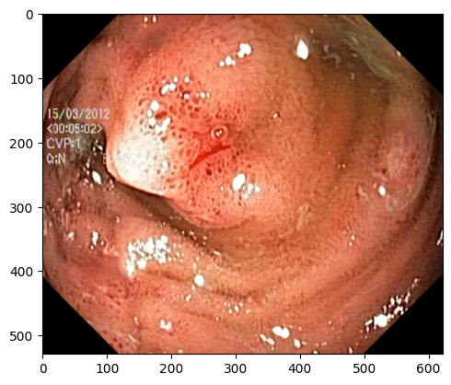
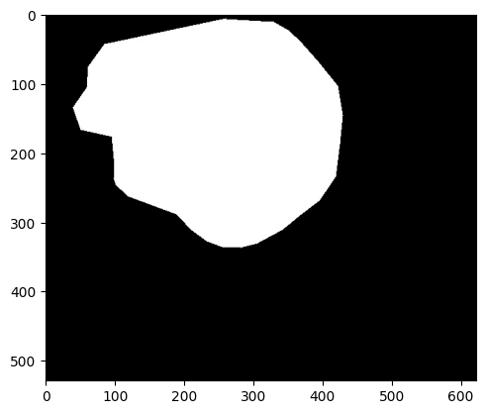
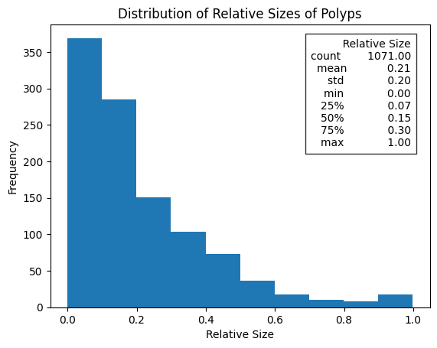
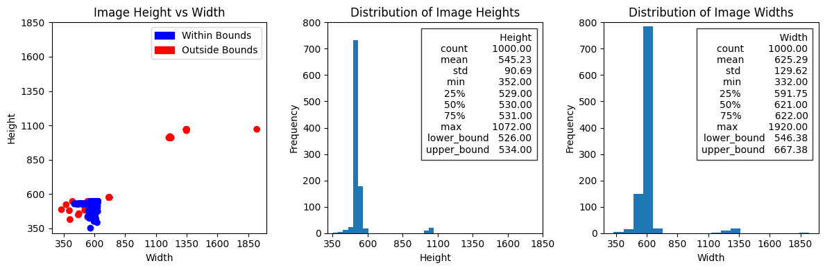
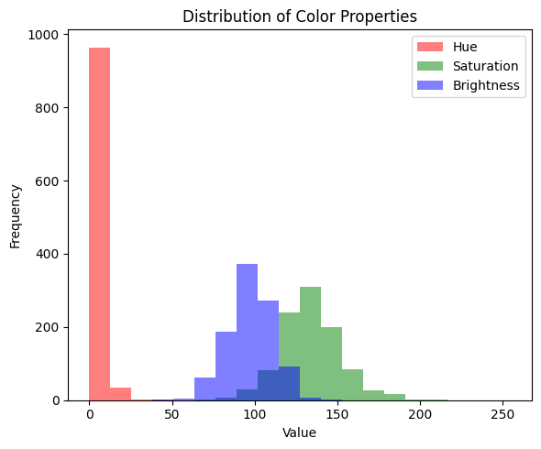
Workflow
1. Data Collection & Preprocessing:
Dataset: Kvasier SEG(1000 images+1000 masks)
Performed EDA on the Dataset:
image mask
Frequency vs Relative size of polyps
Distribution of Height and Width
Distribution of Colour Properties

Slide 3
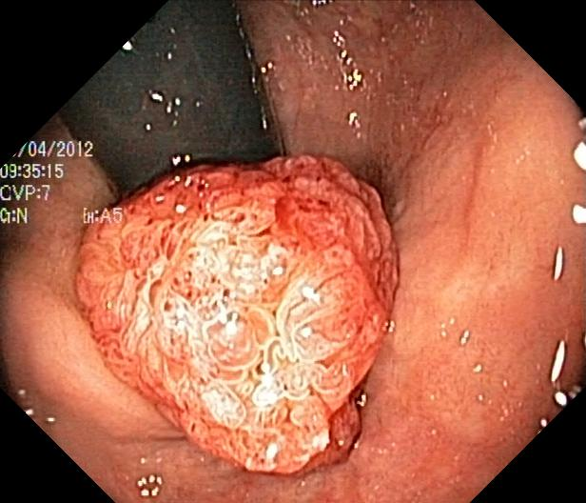
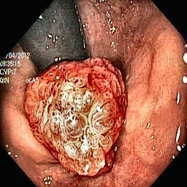
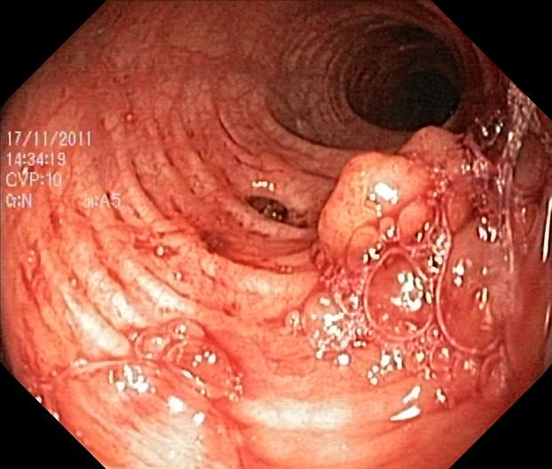
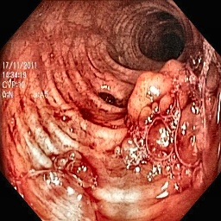
Workflow
Preprocessing the Images:
Applied CLAHE (Contrast Limited Adaptive Histogram Equalization) on RGB images
Performed normalization and resized all images to 256×256
Implemented data augmentation techniques to enhance dataset diversity
Train-Test Split:
60% Training, 20% Validation, 20% Testing for balanced learning
Before Preprocessing After Preprocessing
Before Preprocessing After Preprocessing

Slide 4
Workflow
2. Model Selection & Architecture:
I. Model Architecture: U-Net
Architecture: UNet (Encoder-Decoder with skip connections)
Input Channels: 3 (RGB images)
Output Channels: 1 (Binary segmentation mask)
Base Features: 64 (Doubles at each downsampling stage)
Encoder: Convolution → ReLU → MaxPool
Decoder: Transposed Convolution → Concatenate (Skip Connections) → Convolution → ReLU
Final Activation: Sigmoid (for binary segmentation)
Training Hyperparameters:
Dataloader Configurations:
Parameter | Value
Image Size | 256x256
Batch Size | 8
Epochs | 50
Learning Rate | 5e-5
Optimizer | AdamW
Weight Decay | 0.01
Loss Function | Combined Loss = 0.5 × BCE + 0.5 × Dice Loss
Scheduler | ReduceLROnPlateau (patience=5, factor=0.1)
Loader | Batch Size | Shuffle | Workers
Train Loader | 8 | Yes | 4
Val Loader | 8 | No | 4
Test Loader | 8 | No | 4

Slide 5
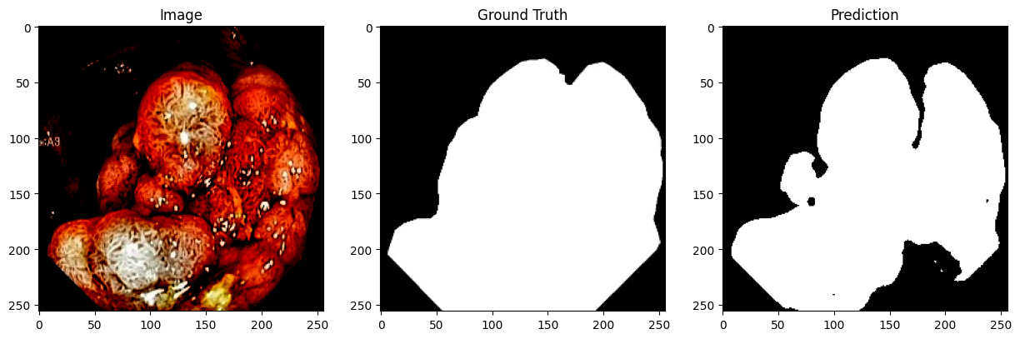
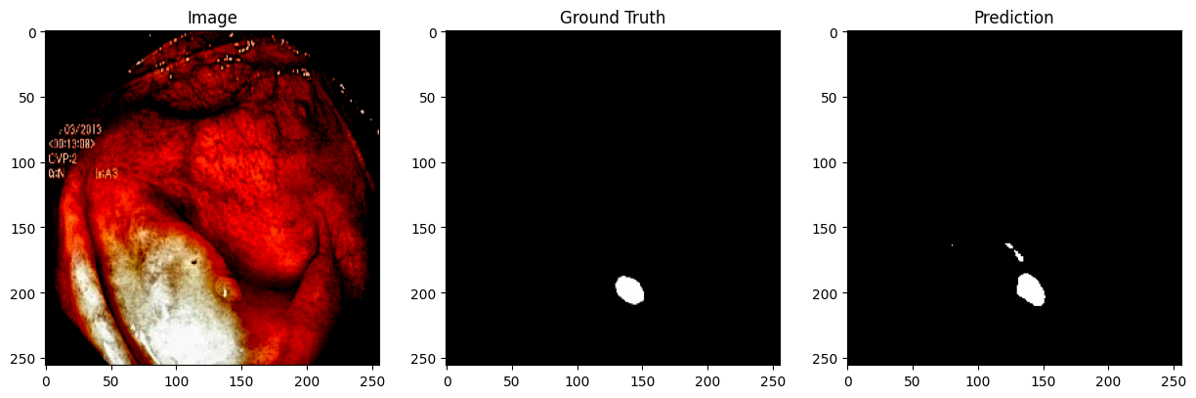
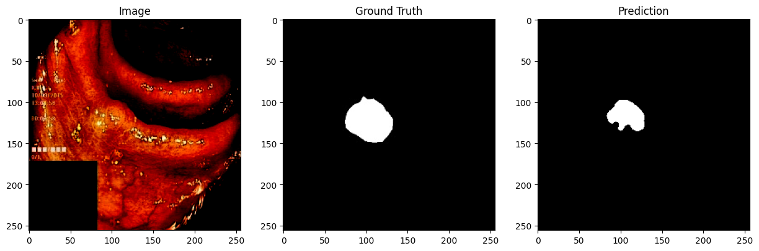
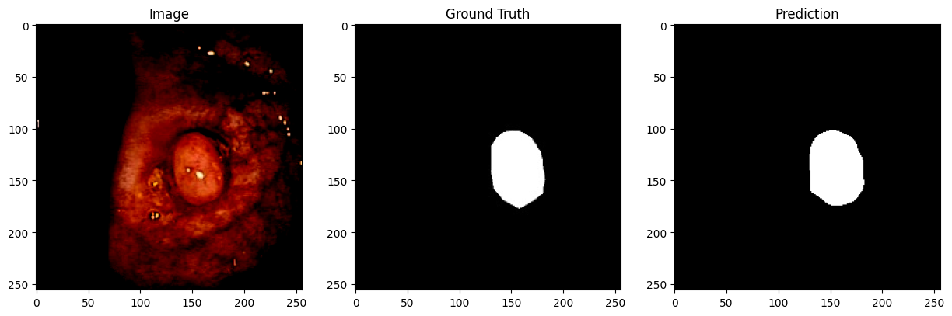
Workflow
Evaluation Metrics: Test Dice Score: 0.8833
Test IoU: 0.7952
Test Accuracy: 0.9417
Model Output:

Slide 6
Workflow
II. Model Architecture:TransU-Net (ViT+U-Net)
Hybrid segmentation model for medical images
Encoder: Vision Transformer (vit_base_patch16_224_in21k)
Decoder: U-Net style CNN decoder with skip connections
Final 1×1 Conv layer produces segmentation mask
Key Components
ConvBlock: Conv2D + BatchNorm + ReLU + Dropout
DecoderBlock: Upsample → Concatenate → ConvBlock
Training Hyperparameters:
Parameter | Value
Optimizer | AdamW
Learning Rate | 1e-4
Epochs | 150
LR Scheduler | StepLR (step=10, γ=0.5)
Initialization | He Normal (Kaiming)
Device | CUDA
Thresholding | Sigmoid + 0.5

Slide 7
Workflow
Training Pipeline:
Apply He initialization to Conv layers
For each epoch:
Train: forward → loss → backward → optimizer step
Validate: compute Dice score
Adjust LR via scheduler
Save best model (best_transunet.pth) based on validation Dice
Loss Functions Used:
I.Combined Loss Function: IoU + Dice
Dice Loss:Measures the overlap between predicted and true masks.
Dice=2TP/2TP+FP+FN​
IoU (Intersection over Union) Loss:Also called Jaccard Index, measures the intersection over the union of predicted and true
IoU=TP/TP+FP+FN​
Loss=𝛼×IoU_Loss+𝛽×Dice_Loss(𝛼=0.5, 𝛽=1)
II. Combined Loss Function: BCE + Dice
Binary Cross-Entropy (BCE):Measures per-pixel classification error
BCE=−1/N∑​[yi​log(pi​)+(1−yi​)log(1−pi​)]
Dice Loss:Measures overlap between predicted & true masks
Dice=2TP/2TP+FP+FN​
Loss= BCE+Dice = α × BCE + β × Dice(α=0.5 & β=1)

Slide 8
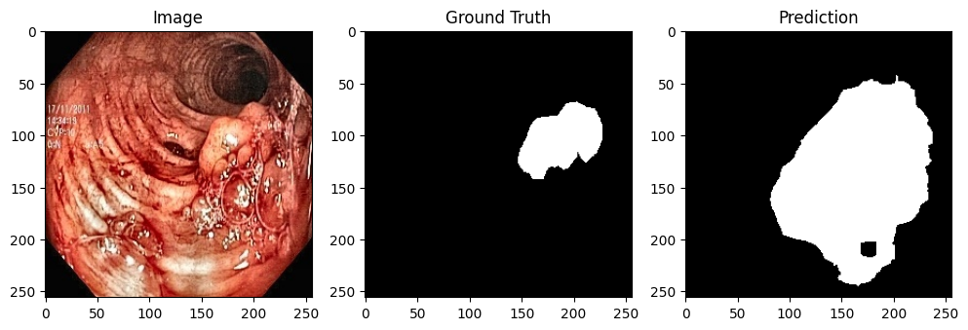
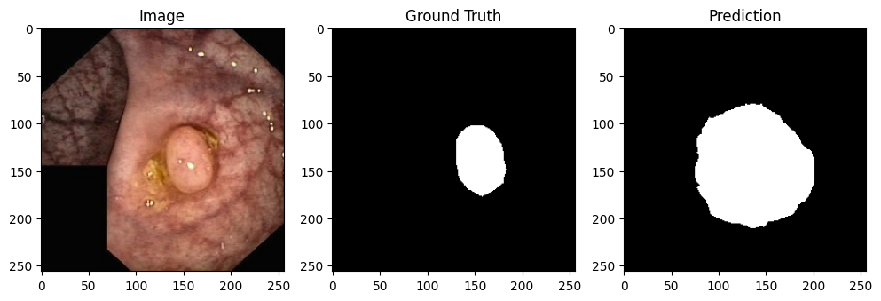
Workflow
I. Combined Loss Function: IoU + Dice
Train Loss: 0.2299,
Val Dice: 0.4593
Model Output:

Slide 9
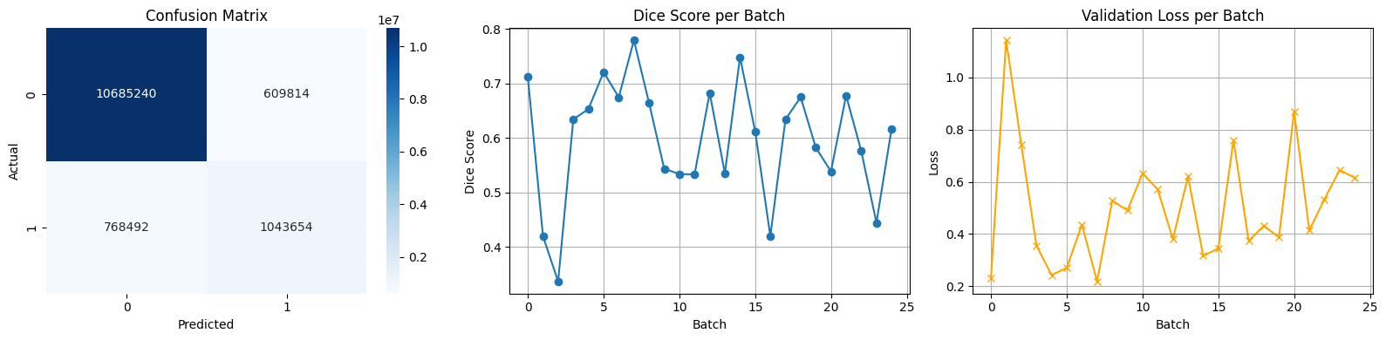
Workflow
II. Combined Loss Function: BCE + Dice
Accuracy : 0.9248
Average Dice Score : 0.8976
Average Validation Loss : 0.5020
Confusion Matrix:
[[10685240 609814]
[ 768492 1043654]]

Slide 10
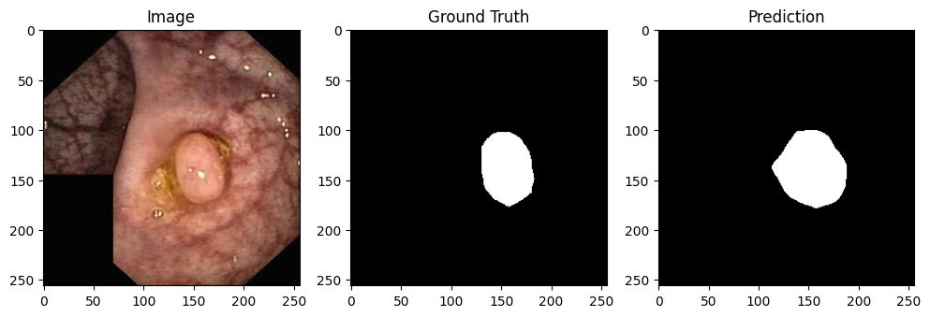
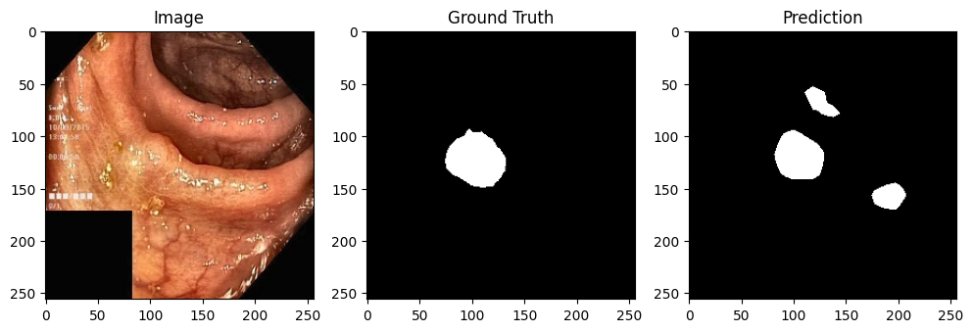
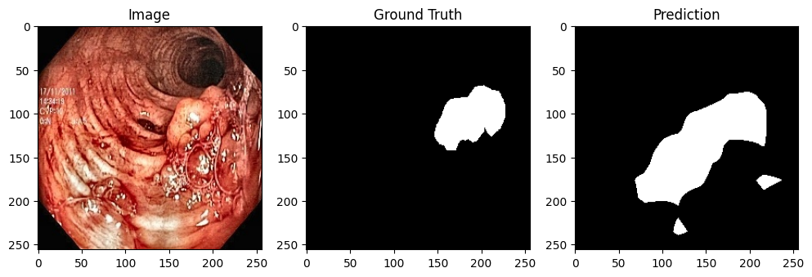
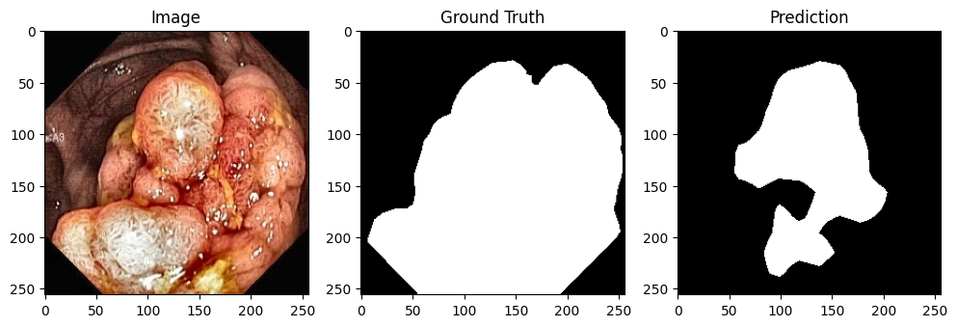
Workflow
Model Output:

Slide 11
References:
Chen, J., Lu, Y., Yu, Q., et al. (2021). TransUNet: Transformers Make Strong Encoders for Medical Image Segmentation. IEEE Transactions on Medical Imaging.
Wang, H., Yang, Y., Xu, Y., et al. (2022). Mixed Transformer U-Net for Medical Image Segmentation. In Proceedings of IEEE ICASSP 2022.
Chen, J., Lu, Y., Yao, H., et al. (2023). 3D TransUNet: Advancing Medical Image Segmentation through Vision Transformers. IEEE Transactions on Medical Imaging (preprint available on arXiv:2310.07781).
Chen, B., Song, Y., Zhang, Z., et al. (2021). TransAttUnet: Multi-level Attention-guided U-Net with Transformer for Medical Image Segmentation. arXiv preprint arXiv:2107.05274.

